Slide 1
CSOPESY
Desktop OS Mock-up
// Guillermo, Iain
// Lee, Hannah
// Lim, Jenrick
CSOPESY [ ]
S01 [ ]

Slide 2
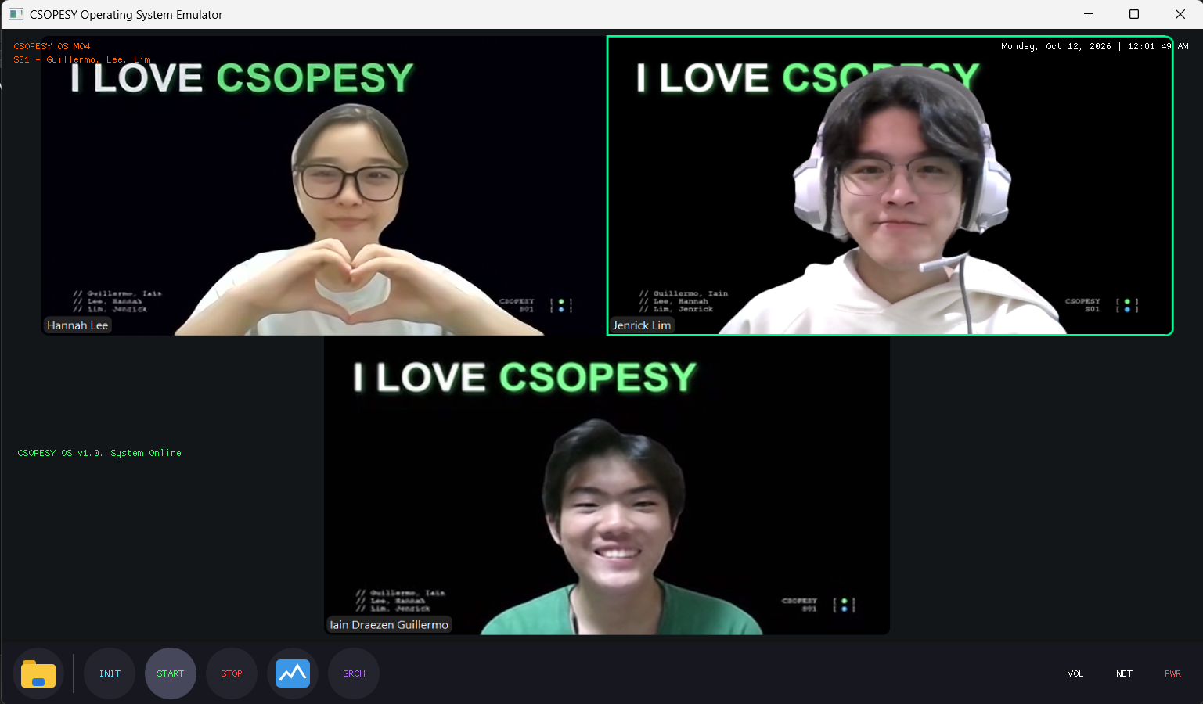
Cover

Slide 3
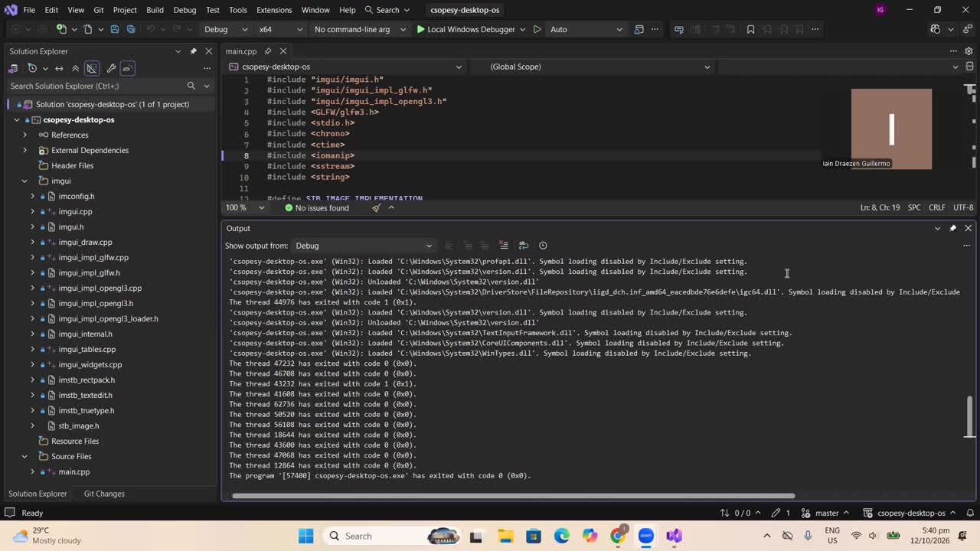
Video Walkthrough

Slide 4
// Renders the three main features to the screen (Desktop, Taskbar, and Task Manager).
// Renders the three required (plus three additional) interactive buttons in the Taskbar
USER INTERFACE LAYER (Dear ImGui)
RenderDesktop
RenderTaskbar
RenderTaskManager
RenderFilesWindow
RenderInitWindow
RenderSearchWindow
// Handles OS state flags, wallpaper image loading via stb_image, and real-time clock formatting
// Handles the authorized system shutdown via Power Button only
OS CORE & STATE LAYER (main.cpp)
State Management
Texture Manager
Time Subsystem
Shutdown Control Mechanism
Architectural Diagram
GRAPHICS & WINDOWING BACKEND LAYER (GLFW3 + OpenGL 3.0)
GLFW3
OpenGL 3.0

Slide 5
Shutdown Logic
Loading of Image Texture
glfwSetWindowCloseCallback(window, [](GLFWwindow* win) {
if (!g_AllowShutdown) {
glfwSetWindowShouldClose(win, GLFW_FALSE);
}
});
if (FlatButton("PWR", ImVec4(1.0f, 0.3f, 0.3f, 1.0f))) {
g_AllowShutdown = true;
glfwSetWindowShouldClose(glfwGetCurrentContext(), GLFW_TRUE);
}
bool LoadTextureFromFile(const char* filename, GLuint* out_texture, int* out_w, int* out_h) {
unsigned char* data = stbi_load(filename, out_w, out_h, NULL, 4);
if (!data) return false;
glGenTextures(1, out_texture);
glBindTexture(GL_TEXTURE_2D, *out_texture);
glTexImage2D(GL_TEXTURE_2D, 0, GL_RGBA, *out_w, *out_h, 0, GL_RGBA, GL_UNSIGNED_BYTE, data);
stbi_image_free(data);
return true;
}
draw_list->AddImage(
(ImTextureID)(intptr_t)g_WallpaperTexture,
pos,
ImVec2(pos.x + customWidth, pos.y + customHeight)
);
Task Manager Table Rendering
struct ProcessRow { const char* name; float cpu; float memory; float disk; float network; };
if (ImGui::BeginTable("ProcessesTable", 5, tableFlags)) {
ImGui::TableSetupColumn("Process Name");
ImGui::TableSetupColumn(cpuHeader); // e.g. "CPU (25%)"
ImGui::TableSetupColumn(memHeader); // e.g. "Memory (82%)"
ImGui::TableHeadersRow();
for (int i = 0; i < numProcessRows; i++) {
ImGui::TableNextRow();
ImGui::TableSetColumnIndex(0); ImGui::Text("%s", processes[i].name);
ImGui::TableSetColumnIndex(1); ImGui::Text("%.1f%%", processes[i].cpu);
ImGui::TableSetColumnIndex(2); ImGui::Text("%.1f MB", processes[i].memory);
}
ImGui::EndTable();
}
Main Loop Rundown
while (!glfwWindowShouldClose(window)) {
glfwPollEvents();
ImGui_ImplOpenGL3_NewFrame(); // Start ImGui Frame
ImGui_ImplGlfw_NewFrame();
ImGui::NewFrame();
RenderDesktop(); // Render OS Layers
RenderTaskbar();
if (g_ShowTaskManager) RenderTaskManager();
ImGui::Render(); // GPU Render & Buffer Swap
glViewport(0, 0, display_w, display_h);
glClearColor(0.08f, 0.08f, 0.08f, 1.00f);
glClear(GL_COLOR_BUFFER_BIT);
ImGui_ImplOpenGL3_RenderDrawData(ImGui::GetDrawData());
glfwSwapBuffers(window);
}
Code Snippets

Slide 6
Design Implementation of OS
// UI DESIGN
  We implemented a custom wallpaper (surprise!) texture for the background, with an active system status indicator (online/stopped), while following the requirements of having a live clock.
  A fixed bottom taskbar acts as the navigation area for the custom interactive buttons that were made.
    Working buttons include the Start, Stop, File Explorer, Init, and Search
// SYSTEM ARCHITECTURE DESIGN
  The system follows a 3-tier layered architecture separating the Dear ImGui presentation layer, main.cpp OS logic, and the GLFW/OpenGL graphics backend.
  Global boolean flags manage application state, controlling the toggle visibility of individual desktop windows and system online modes (online/stopped).
  The custom wallpaper was implemented using stb_image.h and uploaded directly into GPU memory as OpenGL 2D textures.
  Unauthorized window closures via the title bar 'X' button are intercepted using glfwSetWindowCloseCallback and rejected unless the taskbar PWR button is clicked.
  Live system time and date formatting are generated using C++ std::chrono and standard time utilities.

